Slide 1
Use Performance Data to Right-Size a Homeless System and Reach Functional Zero for All Populations
Focus Strategies

Slide 2
Use Performance Data to Right-Size a Homeless System and Reach Functional Zero for All Populations
Focus Strategies
About Focus Strategies
We believe the HEARTH Act and Opening Doors lead the way to finally ending homelessness.
Notes:
Focus Strategies works with communities to:
Assess and improve the quality of local homeless data for informing change
Analyze system outcomes and costs
Synthesize data from multiple systems of care (homeless, mental health, human services, etc.) to identify client overlap and service utilization patterns
Identify how system resources are currently invested & recommend how they can be repurposed to be more effective

Slide 3
Use Performance Data to Right-Size a Homeless System and Reach Functional Zero for All Populations
Focus Strategies
Ending Homelessness
The HEARTH Act establishes:
“…a Federal goal of ensuring that individuals and families who become homeless return to permanent housing within 30 days.”
Opening Doors, As Amended in 2015:
“systematic response …that ensures homelessness is …a rare, brief, and non-recurring experience.”
Notes:
What does it mean for homelessness to be ended? The HEARTH Act gives a good definition, which is that everyone who becomes homeless returns to homelessness in 30 days. The HEARTH Act as recently amended provides an operational definition of the end of homelessness as being when a community has a systematic response in place to ensure homelessness is rare, brief and non-recurring. To end homelessness we need effective Housing Crisis Response Systems that quickly return people to housing. For the purpose of designing an HCRS, communities can use the goal of having no one homeless longer than 30 days as a measurable objective that ensures homelessness is rare, brief and non-recurring…the HEARTH language and Opening Doors language each are different ways of saying the same thing.

Slide 4
Use Performance Data to Right-Size a Homeless System and Reach Functional Zero for All Populations
Focus Strategies
Principles of a Homeless Crisis Response System
Housing-focused
Person-centered
Data-informed
Effective use of resources
Notes:
Housing Focused: An HCRS is built upon the understanding that homelessness is a crisis – the loss of housing – and the solution is to quickly return people to housing. Homelessness is not an intrinsic characteristic of a person and people do not need to be “fixed” before they can be housed. The purpose of an HCRS is to identify an appropriate housing solution for each homeless household, and along the way to connect them to other services they might need.
Person-centered: An HCRS is focused on meeting people’s needs for housing, not on meeting provider needs to fill their programs. It respects client choice and preferences about where and how they will be housed. They system is also easily understood and navigated by homeless people, with minimal barriers to access.
Data-informed: Data is collected and analyzed to understand whether the HCRS is meeting its objectives and to improve effectiveness. Decisions about what approaches to invest in are informed by data, not by assumptions about what works.
Effective Use of Resources. The HCRS is designed to achieve the best possible results using the resources that exist (and realistic expectations about what additional resources can be garnered). While ideally we would provide a permanently affordable housing unit or subsidy to each homeless household, the HCRS recognizes that we can make a huge impact on reducing homelessness with the resources we have at our disposal if we make data informed decisions about how to spend them.

Slide 5
Use Performance Data to Right-Size a Homeless System and Reach Functional Zero for All Populations
Focus Strategies
A System to End Homelessness
Ending homelessness means building systems that:
Divert people from entering homelessness
Quickly engage and provide a suitable intervention for every household’s homelessness
Have short lengths of stay in programs
Have high rates of permanent housing exits
Use data to achieve continuous improvement
Notes:
What are the features of an HCRS? Based on available evidence and experience from communities that have made great strides towards ending homelessness, we had identified the following as the key features of a system to end homelessness or Homeless Crisis Response System.

Slide 6
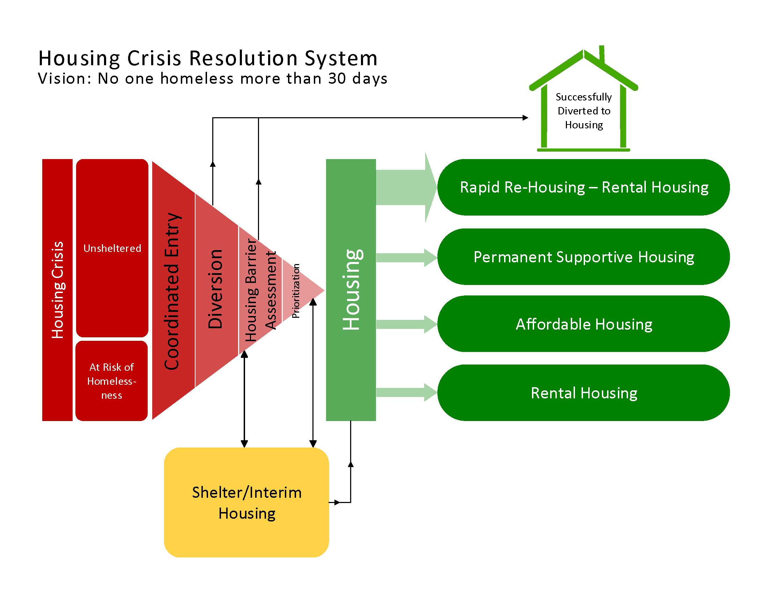
Use Performance Data to Right-Size a Homeless System and Reach Functional Zero for All Populations
Focus Strategies
Homeless Crisis Response System

Slide 7
Use Performance Data to Right-Size a Homeless System and Reach Functional Zero for All Populations
Focus Strategies
Performance Measurement

Slide 8
Use Performance Data to Right-Size a Homeless System and Reach Functional Zero for All Populations
Focus Strategies
Performance Data
Analysis of performance data tells us:
Extent to which homelessness is rare, brief and non-recurring
Where to target efforts to become more effective
How to prioritize system and program resources
How to achieve continuous improvement

Slide 9
Use Performance Data to Right-Size a Homeless System and Reach Functional Zero for All Populations
Focus Strategies
Purpose of SWAP
Can answer these questions (and more!):
Are the local homeless system interventions sized to house the homeless population you have?
Does the speed of your system change match the urgency of the issue?
How is each project type performing?
How is each project performing?
How are systems changes panning out?
Does what people say about community programs and conditions match the data?
Are dollars achieving highest and best impact?

Slide 10
Use Performance Data to Right-Size a Homeless System and Reach Functional Zero for All Populations
Focus Strategies
SWAP Performance Measures
HMIS Data Quality
Bed/Unit Utilization
Entries from Homelessness
Length of Stay
Exits to Permanent Housing (PH)
Cost per Permanent Housing Exit
Returns to Homelessness

Slide 11
Use Performance Data to Right-Size a Homeless System and Reach Functional Zero for All Populations
Focus Strategies
HUD System Performance Measures
The SWAP measures are aligned with how HUD views system performance
Strong performance on the SWAP metrics will result in strong results on the HUD measures
SWAP does not directly address income or employment (though anticipated impacts can be modeled)
SWAP does measure cost effectiveness

Slide 12
Use Performance Data to Right-Size a Homeless System and Reach Functional Zero for All Populations
Focus Strategies
Base Year Calculator (BYC)
What is it?
What data does it use?
What outcomes are produced?
What comes next?

Slide 13
Use Performance Data to Right-Size a Homeless System and Reach Functional Zero for All Populations
Focus Strategies
The BYC is…
A publically available, web-based tool that uses a community’s HIC, HMIS, and program budget data to asses performance
Notes:
Evaluates performance at the project level giving the ability to look at each individual project and the system as a whole.
Look at projects of the same type side by side = useful when evaluating performance
What data sources are used?....

Slide 14
Use Performance Data to Right-Size a Homeless System and Reach Functional Zero for All Populations
Focus Strategies
Data Sources
Housing Inventory Count (HIC)
Raw HMIS data
Project budget data
Notes:
Foundation for the BYC is HIC – HIC gives picture of homeless housing system. Should be complete and comprehensive view of all beds/units dedicated to homeless in community.
Which projects enter data into HMIS?
Those who don’t have comparable data?
HMIS data – BYC uses two full years of data (first year for returns, 2nd year to measure outcomes); want recent data but also want complete data. Don’t want too far in the past also don’t want to recent past where data may be incomplete. The HIC will guide your data pull. Likely there are projects on the HIC not in HMIS so wont be able to analyze them. If you can get comparable data and are confident in quality you can use that.
Crosswalk!!! Complicated process and extremely important to ability to analyze projects. Need to know which are being analyzed and how to fully represent them in the data.
Use very few, straight forward data elements; however, BYC looks at household level data not client = need global HH ID to follow households through the system. This seems hard for some communities
Most unique thing about BYC = cost analysis. We use program budget data to analyze the cost per permanent housing exit by program. Ask each provider to report on the total operating budget (including all funding sources) for each project. Collecting budget data is most difficult part of the process – providers not open to sharing, information hard to collect because multiple funding sources, process takes significant amount of time with back and forth communication.

Slide 15
Use Performance Data to Right-Size a Homeless System and Reach Functional Zero for All Populations
Focus Strategies
Outcomes
What does the BYC produce?
How do these measures differ from HUD performance measures?
Common findings/issues

Slide 16
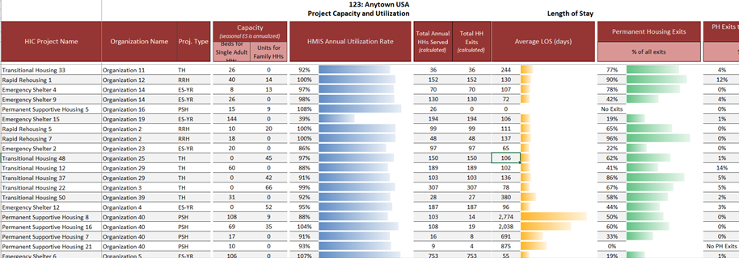
Use Performance Data to Right-Size a Homeless System and Reach Functional Zero for All Populations
Focus Strategies
Project Performance
Performance measures by project
Notes:
Data you’ll see if from “anytown USA” which is aggregated/averaged data from multiple communities across the country and is a few years old at this point. The show characteristics that are most common among the communities we work with. Of course each community has its own unique strengths and challenges.
Performance measures:
Utilization rate, length of stay, analysis of entries and exits, cost per permanent housing exit, and returns within 1 year. All measures for each individual project then can roll up by project type….

Slide 17
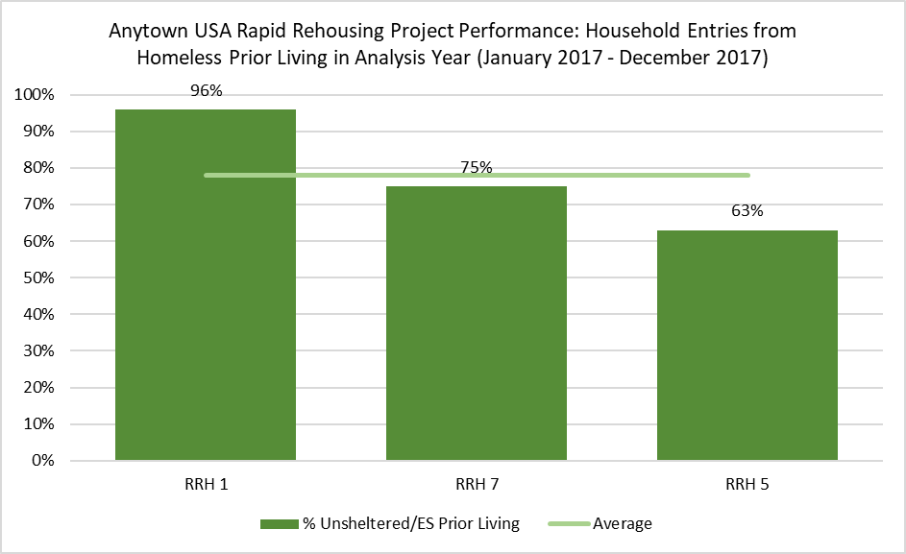
Use Performance Data to Right-Size a Homeless System and Reach Functional Zero for All Populations
Focus Strategies
Project & System Performance
Use data to create graphs
Notes:
Use data to analyze individual project performance; project performance for each project of a specific type; and of each type in the system

Slide 18
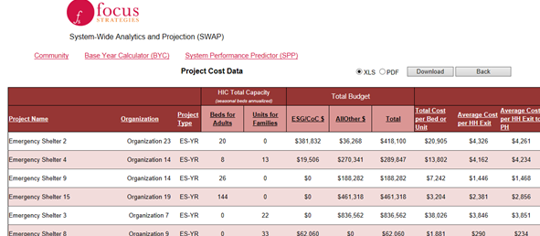
Use Performance Data to Right-Size a Homeless System and Reach Functional Zero for All Populations
Focus Strategies
Project & System Performance
Performance measures include cost per permanent housing exit
Notes:
Calculate cost per permanent housing exit for each project.
Have to take other measures into account – if all things = and proj A cost way more than proj B; proj A super cheap but only exits ½ the people to PH than more expensive proj B….(see next slide)

Slide 19
Use Performance Data to Right-Size a Homeless System and Reach Functional Zero for All Populations
Focus Strategies
Project & System Performance
Performance measures include cost per permanent housing exit
Notes:
Like here:
We are all well aware by now that generally TH is very expensive with equal, or even lower performance, than RRH. This data shows inexpensive ES. TH being 3x more expensive than RRH is not uncommon.

Slide 20
Use Performance Data to Right-Size a Homeless System and Reach Functional Zero for All Populations
Focus Strategies
Data Quality
Notes:
BYC assess % of missing/unknown data, for both years, for Prior Living and Destination. Missing % are for individual clients and households.
Also looks at length of stay, UR, and HHs served as DQ measures.
Significant variance in LOS could be DQ issue, negative LOS of course DQ issue
HHs served = The BYC calculates the total households served and exited in a year using the project's point in time capacity (count of beds/units), calculated utilization rate based on HMIS data, and length of stay. = (PIT capacity x ((365 x utilization rate) ÷ length of stay); BYC shows this number of calc HHs and actual HMIS HHs served where a major difference could indicate DQ issue with entry/exits

Slide 21
Use Performance Data to Right-Size a Homeless System and Reach Functional Zero for All Populations
Focus Strategies
HUD System Performance Measures
People not households
Returns
Notes:
Most notable differences:
BYC looks at households not people
Returns – byc only looks at within 12 months, no breakdown
BYC UR is annualized using bed nights available and bed nights used in HMIS data = different than a PIT UR

Slide 22
Use Performance Data to Right-Size a Homeless System and Reach Functional Zero for All Populations
Focus Strategies
Common Findings/Issues
Data Quality
“This data is wrong”
Notes:
Data quality may be poor – if lots of missing/unknown prior living/destination = really difficult to interpret system movement
Data quality issues due to entry – choosing temporary friends/family because didn’t look down to see permanent
Providers are often shocked –
haven’t looked at data in this way; actual graphs are presenting data differently than they’ve seen it before. And now shocked at what they see
didn’t realize before that data was being entered incorrectly or maybe not at all

Slide 23
Use Performance Data to Right-Size a Homeless System and Reach Functional Zero for All Populations
Focus Strategies
What’s next?
Data clean-up
Modeling
Notes:
Depending on what you found in BYC, may need to do some data clean-up. Rinse and repeat!!! You’ll want to do this on a regular basis and be sure your data is accurate in order to have an accurate model.
SPP!!!!

Slide 24
Use Performance Data to Right-Size a Homeless System and Reach Functional Zero for All Populations
Focus Strategies
System Performance Predictor (SPP)
What is it?
What data does it use?
What outcomes are produced?
What comes next?

Slide 25
Use Performance Data to Right-Size a Homeless System and Reach Functional Zero for All Populations
Focus Strategies
The SPP is…
An Excel-based modeling tool that uses performance data from the BYC and community population data to model changes to the homeless population
Notes:
Evaluates performance at the project level giving the ability to look at each individual project and the system as a whole.
Look at projects of the same type side by side = useful when evaluating performance
What data sources are used?....

Slide 26
Use Performance Data to Right-Size a Homeless System and Reach Functional Zero for All Populations
Focus Strategies
Data Sources
Program Performance Data from BYC
Point In Time Count Data
Poverty Population Data
Notes:
Reference BYC, which generates performance data for each project – enter into SPP
Enter unsheltered data from the PIT that matches your BYC analysis year
Enter poverty population and estimate percentage of poverty population that will become homeless each year/households who will self-resolve their housing crisis

Slide 27
Use Performance Data to Right-Size a Homeless System and Reach Functional Zero for All Populations
Focus Strategies
Starting PIT Population
Households Becoming Homeless
Households Housed
Ending PIT Population
How It Works
Notes:
The SPP determines the number of households needing housing from the data you entered and uses the BYC performance data to model the number of households who can be served and successfully housed each year. It subtracts households successfully housed from the number needing housing to model the PIT population at the end of each model year. Usually, the SPP models 4 years of performance, but that can be customized based on community goals.

Slide 28
Use Performance Data to Right-Size a Homeless System and Reach Functional Zero for All Populations
Focus Strategies
Outcomes
Unsheltered and Sheltered Homeless Population
Households Served in Each Project Type
Unused System Capacity
Notes:
Describe SPP outputs. Mention breakdown by subpopulations: unsheltered/sheltered, adult/family, Vet/TAY/CH

Slide 29
Use Performance Data to Right-Size a Homeless System and Reach Functional Zero for All Populations
Focus Strategies
Outcomes – Maintaining Status Quo
Family
Adult
-1%
Notes:
For simplicity, just show unsheltered population with adult/family. With the community’s current inventory and performance, the SPP estimates that their unsheltered population will remain virtually the same over the next four years. The adult unsheltered population should decrease, but alarmingly, the family unsheltered population will grow.

Slide 30
Use Performance Data to Right-Size a Homeless System and Reach Functional Zero for All Populations
Focus Strategies
System Planning – Modeling Workbook
Planned Inventory Changes
New Initiatives
Performance Targets
Notes:
Tell us what changes you’re planning to make over the next few years. Have you added, or do you plan to add any inventory? What impact do you expect new community initiatives to have? What are your system performance targets?

Slide 31
Use Performance Data to Right-Size a Homeless System and Reach Functional Zero for All Populations
Focus Strategies
Change Strategy – Add PSH
Only 25 PSH units available each year
Add two new PSH projects:
Project 1: 100 adult beds
Project 2: 30 family units
Notes:
Based on the community’s performance data and PSH capacity, only 25 PSH units become available each year, which isn’t many considering the size of their homeless population. Community plans to open two new PSH projects in 2018. One will have 100 adult beds, while the other will have 30 family units.

Slide 32
Use Performance Data to Right-Size a Homeless System and Reach Functional Zero for All Populations
Focus Strategies
Outcomes – Add PSH
Family
Adult
-6%
Notes:
Good news: adding PSH capacity decreases the unsheltered population by 6%, and that decrease is sustained over the following years. Unfortunately though, we don’t see similar decreases in subsequent years, because PSH turnover is low. The unsheltered family population is still growing, and in the end, there are still over 1000 unsheltered households in the community. While the increased PSH inventory helped, we’re going to need more than just a couple of new PSH projects to reduce the number of households experiencing unsheltered homelessness in our community.

Slide 33
Use Performance Data to Right-Size a Homeless System and Reach Functional Zero for All Populations
Focus Strategies
Change Strategy – Reallocate Funds to RRH
Can serve over 1000 households in TH, but only 250 in RRH
Reallocate TH funds to add two RRH projects:
Project 1: 62 adult beds
Project 2: 60 family units
Notes:
The community’s performance data shows that they have capacity to serve 1000 households in TH, but only 250 in RRH, even though RRH performance is quite good. Recall from the BYC data that it costs nearly 3x as much per PH exit in TH than in RRH. As many of your communities have already done, this community plans to open reallocate some of its TH funding to support two new RRH projects. One will have 62 adult beds, while the other will have 60 family units. One adult TH project with 60 adult beds will close, while one family TH project will decrease its capacity by half, from 66 family units to 33. Notice that because RRH costs are lower, the same amount of investment can be used to create more capacity.

Slide 34
Use Performance Data to Right-Size a Homeless System and Reach Functional Zero for All Populations
Focus Strategies
Outcomes – Reallocate Funds to RRH
Family
Adult
-48%
Notes:
Adding RRH results in much more sustainable decreases in the unsheltered population –48% over four years. The unsheltered family population is no longer growing, and the number of unsheltered adults are diminishing more rapidly. Still though, there are almost 600 unsheltered households remaining at the end of the modeling period, so we need to do more if we want to reach functional zero.

Slide 35
Use Performance Data to Right-Size a Homeless System and Reach Functional Zero for All Populations
Focus Strategies
Change Strategy – Improve Performance
Lots of entries from housing and exits to unknown destinations
Improve project performance:
Decrease entries from housing by half
Improve data quality to decrease exits to unknown destinations by half
Decrease ES length of stay
Notes:
The community’s performance data shows that they serve a large number of households entering the system from housed situations. These households may be better served through diversion, making space available to serve unsheltered households. Furthermore, the BYC data quality analysis showed a significant number of exits from ES to unknown destinations. The community improves their data quality controls, resulting in more recorded exits to permanent housing. Lastly, the community transitions to a housing-focused shelter model, resulting in decreased ES length of stay. We modeled these by decreasing entries from housing by half and instead taking those households from unsheltered locations, decreasing exits to unknown destinations by half and adding those as exits to PH, and decreasing average length of stay for ES to from 60 days to 45.

Slide 36
Use Performance Data to Right-Size a Homeless System and Reach Functional Zero for All Populations
Focus Strategies
Outcomes – Improve Performance
Family
Adult
-100%
Notes:
Improving performance the year after addition of the new inventory makes a huge difference in the unsheltered population…so much so that by 2020, the modeled unsheltered PIT population is zero. Of course, this doesn’t mean that there are no more homeless people, but it does suggest that with good performance, this community will be able to provide shelter to and eventually house their entire unsheltered population.

Slide 37
Use Performance Data to Right-Size a Homeless System and Reach Functional Zero for All Populations
Focus Strategies
What’s next?
Review of how changes affect population
Recommendations for right sizing system
Notes:
How do we want to conclude? Do we usually recommend things that we didn’t model? Look at sheltered population, subpopulations, households served, and whether there’s unused capacity.

